Slide 1
Hurricane Preparedness
2024 Season

Slide 2
Hurricane Preparedness
Introduction
Information about Tropical Cyclones
Before the storm
Know your NEW Evacuation Zone
Evacuation Route
After the storm
Important resources
Questions

Slide 3
Introduction
Chris Seabolt, former Fire Chief JIPSD
  30+ years in Emergency Service with 23 on James Island
Tonight, we will be discussing:
  Hurricane Preparedness
  2024 Hurricane Season
Main First Responders
  JIPSD Fire Department, Solid Waste, and Wastewater Services
  Charleston County Sheriff’s Office
  Charleston Emergency Medical Services

Slide 4
Tropical Cyclones
Tropical Depression-the weakest tropical cyclone having maximum sustained winds of 38mph or less
Tropical Storm-mid-level tropical cyclone having maximum sustained winds between 39 and 73mph
Hurricane-the strongest tropical cyclone having maximum sustained winds over 74mph
  Hurricane Alan in 1980 had the highest recorded winds of 190mph

Slide 5
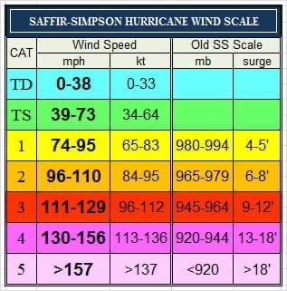
Tropical Cyclone
  Saffir-Simpson Scale

Slide 6
Tropical Cyclones
Watches and Warnings
  Watches are issued 48 hours prior to “expected” landfall of a tropical cyclone
  Warnings are issued 36 hours prior to “expected” landfall of a tropical cyclone
Storm Surge-the abnormal rise in sea level during a storm, measured as the height of water over the predicted astronomical tide.
  Causes more deaths than high winds
  The highest recorded storm surge in South Carolina was during Hurricane Hugo in 1989 in McClellanville and exceeded 20 feet

Slide 7
Tropical Cyclones
NOAA 2024 Predictions
  85% chance of being above average this year
  Forecasting between 17 and 25 named storms
  Between 8 and 13 hurricanes
  And between 4 and 7 major storms (Category 3 or higher)
  This is the highest number of named storms and major hurricanes forecast ever issued in May
  An average season is considered to have 14 named storms, 7 hurricanes, and 3 major hurricanes
  2020 has the record for the most named storms at 30

Slide 8
Before the Storm
Check Homeowner’s Insurance
  Regular policies do not cover flood damage from Tropical Cyclones
  Investigate the National Flood Insurance Program
    Flood policies can take 30 days to take effect once purchased
Develop an Emergency Communications Plan
  Create a plan to reunite family members if separated during an emergency
  Ask an out-of-state family member to be a point of contact
  Make sure all family members have important numbers and contact information

Slide 9
Before the Storm
Create an Emergency Evacuation Plan
  Determine a location to evacuate
  Determine when to leave
  Determine who will go with whom
  Follow evacuation routes
Be able to respond
  Teach family members how to turn off gas, water, and electricity
  Teach children how and when to use 9-1-1

Slide 10
Before the Storm
Create an Emergency Supply Kit
  Minimum of 72-hours worth of supplies, as it may take a while to get to you due to flooding or damage
  Include items like:
    Water and Non-perishable food
    Cash and Important Documents
    Toiletries and toilet paper
    Medicines and a first aid kit
    Pet food and medication
    Batteries, battery-powered lights, and a NOAA weather radio
    Phone or other types of chargers
    Extra clothing

Slide 11
Before the Storm
Prepare your home
  Check roof and roof sheathing
  Secure garage doors
  Secure storm shutters or board windows
  Secure any loose outdoor materials, such as:
    Garbage cans
    Outdoor furniture
    Plants
  Check generator (if you have one) and make sure you have extra fuel

Slide 12
Know your NEW Evacuation Zone
The state has developed new evacuation zones for 2024
James Island is now in Zone “B” we used to be in Zone “A”

Slide 13
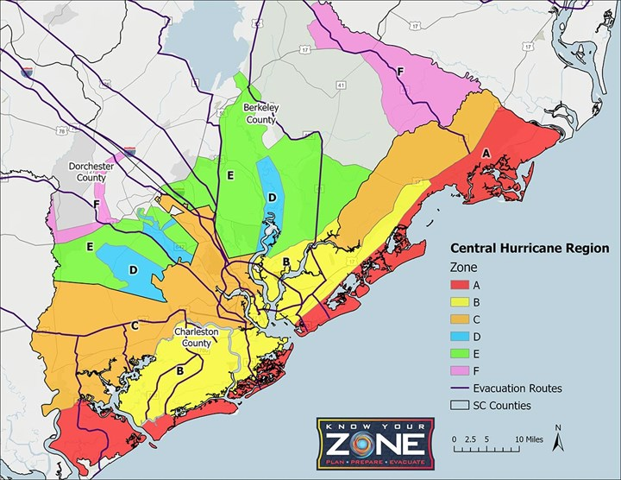
Know your NEW Evacuation Zone

Slide 14
Know your Evacuation Route
Residents of James Island are directed to use Folly Road (SC 171) to Savannah Highway South (US 17) to I-526 to the reversed lanes on I-26
The lanes on I-26 are typically reversed sometime after the governor has issued a mandatory evacuation order and all appropriate resources are in place

Slide 15
After the Storm
Wait for All-Clear notice to be given to return
Re-enter your home carefully
Stay away from downed powerlines and any water near them
Do not attempt to traverse flood waters as they may be deeper than you think
Stay out of flood waters as they are likely contaminated
Beware of snakes or other animals that may have been driven to higher ground because of flooding

Slide 16
After the Storm
Make sure to clean and disinfect anything in your home that got wet
Use appropriate personal protective equipment (PPE), gloves, boots, safety glasses, masks, etc. when cleaning or removing debris
Make sure you have been properly trained in the use of equipment like a chainsaw if you intend to use it
Do not operate generators, grills, etc. inside a home, or garage, or any enclosed space

Slide 17
After the Storm
Use good storm debris management by separating debris using the CHEAT method
  C-Construction Waste
  H-Hazardous residues
  E-Electronics
  A-Accessories
  T-Trees and vegetation
Place debris
  Within 15 feet of roadway
  Between road and sidewalk, if there is one

Slide 18
Important Resources
Important links
  www.jamesislandsc.us/emergency-preparedness
  www.jipsd.org
  www.charlestoncounty.org/departments/emergency-management
  www.scemd.org
Important phone numbers
  9-1-1 for emergencies
  (843) 795-4141 Town of James Island (active during emergencies)
  (843) 743-7200 Charleston County non-emergency Public Safety

Slide 19
Questions
Any questions?

